Slide 1
RESUME WRITING

Slide 2
WHAT IS RESUME?
a summative document representing a person’s individual career experiences and accomplishments
to help people market themselves and serve as a first introduction between job seekers and employers
helps an employer understand the skills, abilities, and qualifications you possess in addition to the academic/work/service experiences, awards, and community involvement you have completed
helps the employer understand how these qualifications/experiences relate to their hiring needs

Slide 3
THE GENERAL RULES OF RESUME WRITING
Resumes should not be a step by step recap of everything you have ever done
Resumes should be written in the third person
Resumes for undergraduates should be confined to one page
Never include a picture on your resume
Do not mention Date of Birth
The use of color and graphics is discouraged for all resumes except those submitted in design or arts industries.

Slide 4
FORMATTING
Your name should be the largest font size of the document (16 – 18 pt. recommended)
It can be in any style you choose as long as it is READABLE (refrain from using script fonts).
Your contact information can be smaller (10 pt. font).
If your email address is automatically made into a hyperlink, remove the hyperlink by highlighting the email address, right clicking, and selecting “remove hyperlink” from the drop down list

Slide 5
Your email ID should be professional. Refrain from making IDs like Prince and Princess.yahoo.com
NU ID will be taken back once you are passed out.
Font size for the body of the document should be either 11 or 12 pt.
in an easy-to-read style (i.e. Times New Roman, Arial, Verdana).
Watch for spacing—be sure that all spacing between sections is consistent.
Dates should all align on the RIGHT side of the page.
List all experiences within a section uniformly.

Slide 6
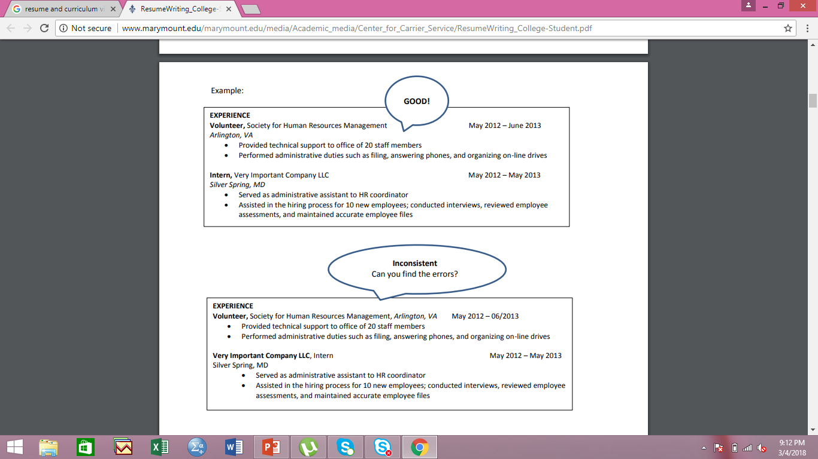

Slide 7
TRADITIONAL RESUME SECTION HEADINGS
Contact Information
OBJECTIVE
QUALIFICATION HIGHLIGHTS/ PROFESSIONAL PROFILE
EDUCATION
EXPERIENCE
RESEARCH and/or PROJECTS
SKILLS
ACTIVITIES/HONORS/AFFILIATIONS

Slide 8
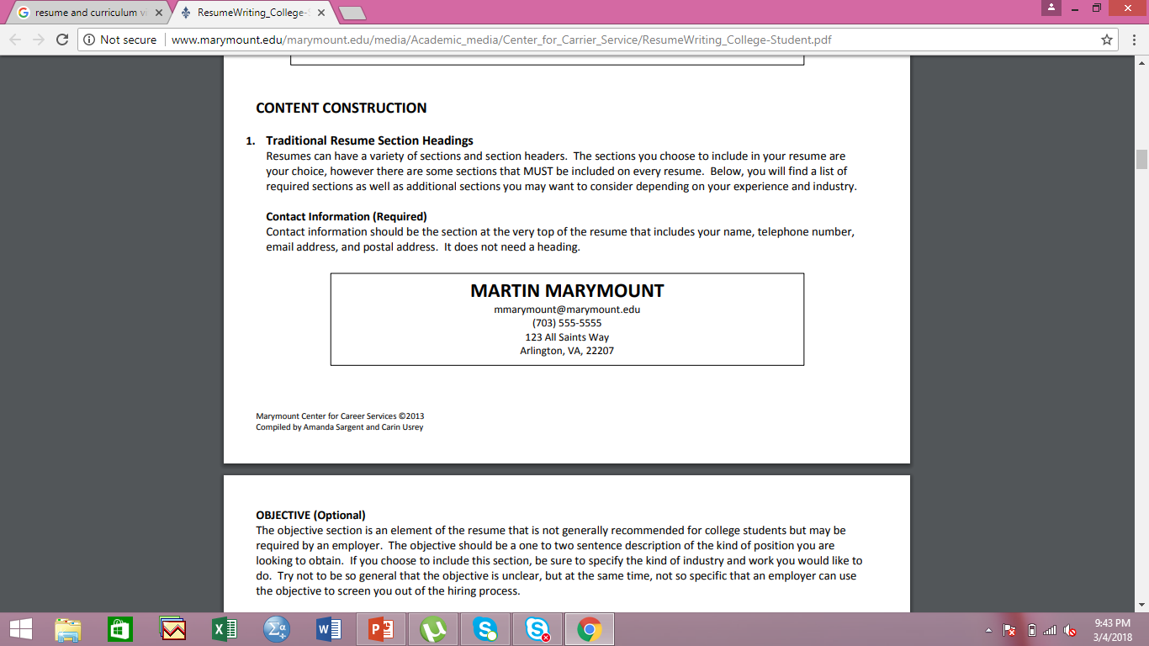
CONTACT INFORMATION
Contact information should be the section at the very top of the resume
It includes your name, telephone number, email address,
Avoid adding your postal address
It does not need a heading.

Slide 9
OBJECTIVE
The objective should be a one to two sentence description of the kind of position you are looking to obtain.
be sure to specify the kind of industry and work you would like to do.
Try not to be so general that the objective is unclear
but at the same time, not so specific that an employer can use the objective to screen you out of the hiring process

Slide 10
EXAMPLES
“Seeking an accounts specialist position at JP Morgan Chase’s Arlington office.”
Too specific! This objective tells the employer that you only want a position as an accounts specialist and only in one branch office. If there is a similar position in a different office, you may not be considered.

Slide 11
“Seeking an internship position.”
Too general! This objective does not add any value to your resume as it does not clarify industry or experiences you are looking to gain.

Slide 12
“Seeking an entry level accounting position in top tier financial services firm with opportunities to both work with a diverse client base and gain experience in corporate accounts. “
Good! A nice balance of the general industry interests and experiences the person is seeking without limiting what they might be considered for.

Slide 13
QUALIFICATION HIGHLIGHTS/ PROFESSIONAL PROFILE
This section can be either a bulleted list or a paragraph summarizing your best qualities and most relevant experiences.
This section gives the employer a general sense of how you are qualified for this position as well as how well your previous experiences have prepared you for the kind of work you may be performing in your new position.

Slide 14
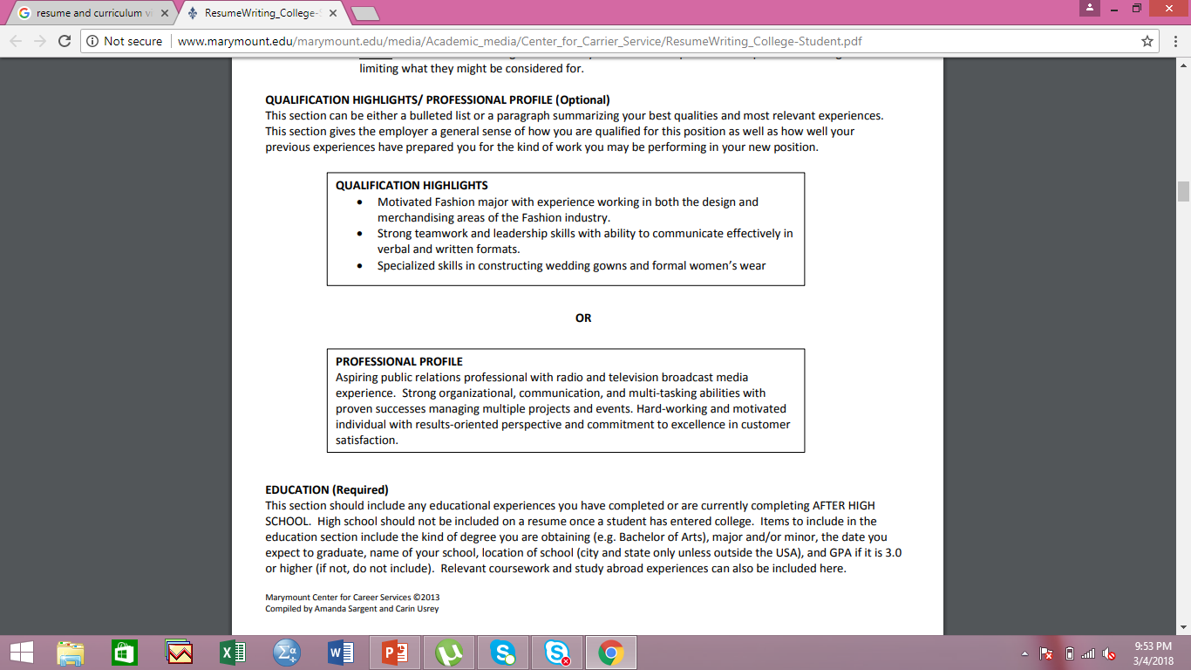

Slide 15
EDUCATION
This section should include any educational experiences you have completed or are currently completing.
Items to include in the education section include the kind of degree you are obtaining (e.g. Bachelor of Arts)
major and/or minor
the date you expect to graduate
name of your school
location of school
GPA if it is 3.0 or higher (if not, do not include).

Slide 16
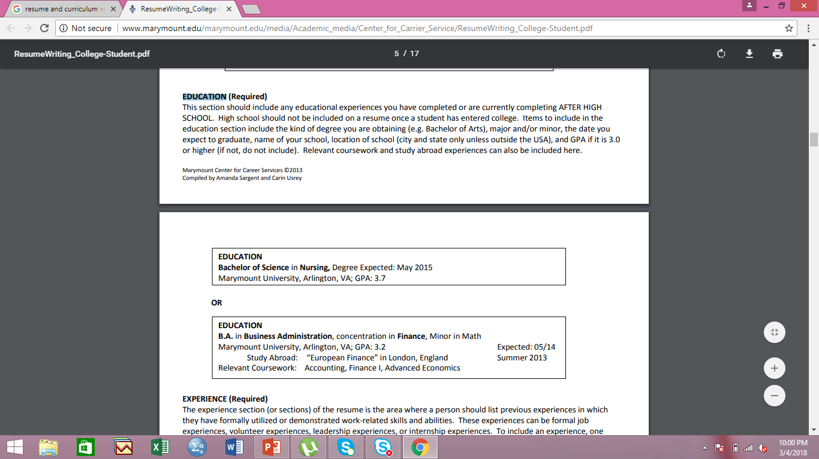

Slide 17
EXPERIENCE
The experience section of the resume is the area where a person should list previous experiences in which they have formally utilized or demonstrated work-related skills and abilities.
These experiences can be formal job experiences, volunteer experiences, leadership experiences, or internship experiences.
To include an experience, one should be able to associate a title with it (e.g. “Volunteer,” “President,” or formal job title).
Experiences should be listed in reverse chronological order (most recent to least recent) and should be formatted uniformly.

Slide 18
COMPONENTS OF EXPERIENCE
The experience description should include the title of your position
the name and location of your company/organization
start and end dates (including month and year)
no less than two bullet points or sentences describing a skill, knowledge set, ability, qualification, or recognition/award received.
Bullet points should emphasize transferable skills and should be no longer than 2 sentences

Slide 19
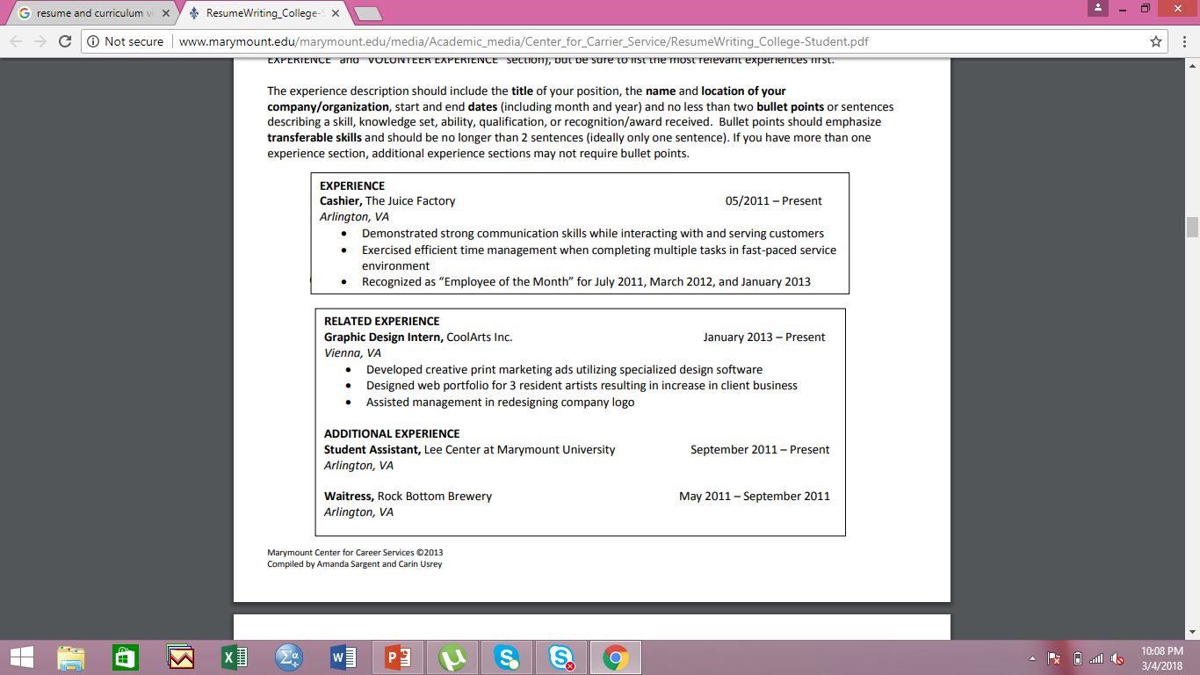

Slide 20
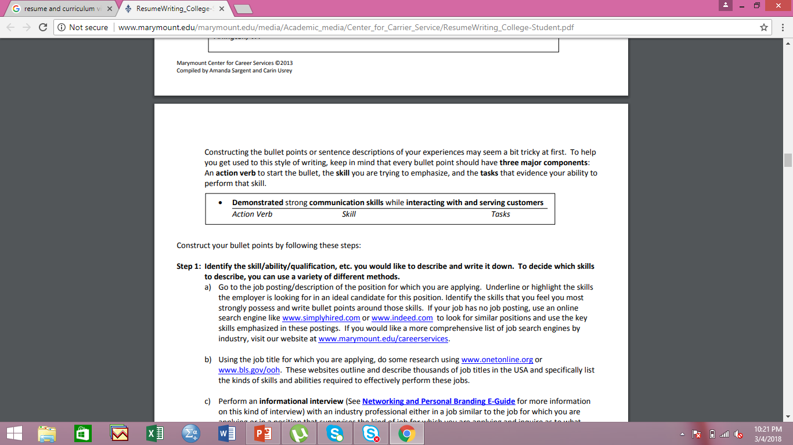
CONSTRUCTING THE BULLET POINTS
Constructing the bullet points or sentence descriptions of your experiences may seem a bit tricky at first.
To help you get used to this style of writing, keep in mind that every bullet point should have three major components:
An action verb to start the bullet,
the skill you are trying to emphasize,
and the tasks that evidence your ability to perform that skill.

Slide 21
Construct your bullet points by following these steps: STEP-1
Identify the skill/ability/qualification, etc. you would like to describe and write it down.
To decide which skills to describe, you can use a variety of different methods.
Go to the job posting/description of the position for which you are applying.
Underline or highlight the skills the employer is looking for in an ideal candidate for this position.
Identify the skills that you feel you most strongly possess and write bullet points around those skills.

Slide 22
STEP-2
Think about the tasks and duties you performed in your experience that effectively evidence your ability to perform this skill. Write these down in a list on a separate sheet of paper.
Example:
Previous position title: Student Front Desk Assistant
Skill: Communication
Tasks:
Talked with customers at the front desk
Answered phones
Wrote emails to clients

Slide 23
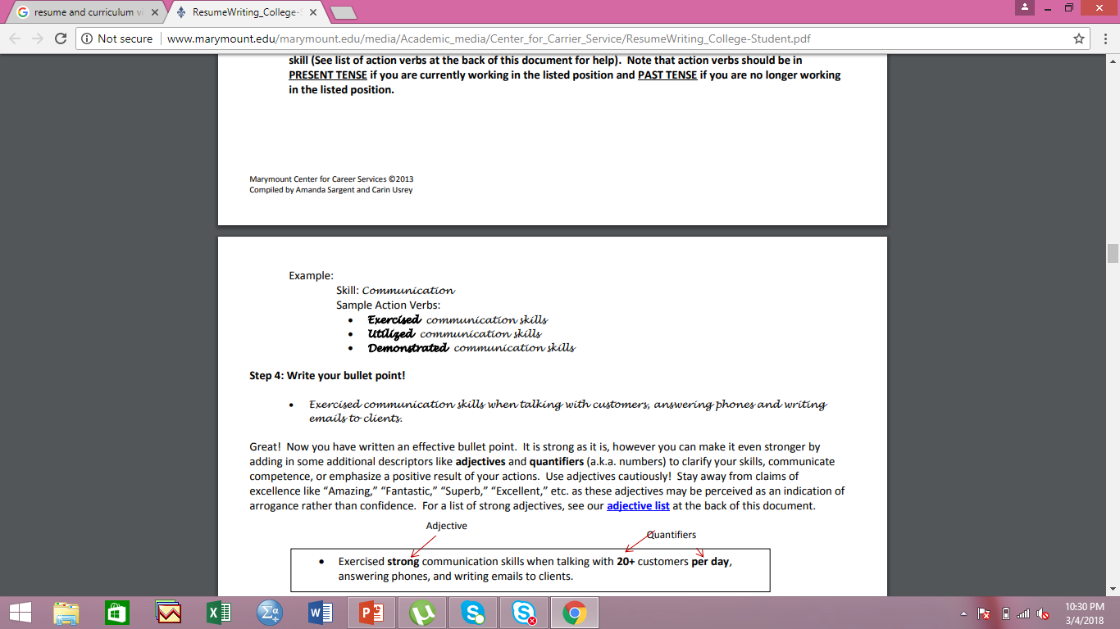
STEP-3
Choose an action verb that helps the employer understand how or in what way you used or demonstrated this skill
Note that action verbs should be in PRESENT TENSE if you are currently working in the listed position
PAST TENSE if you are no longer working in the listed position

Slide 24
STEP-4
Write your bullet point!
Example:
Exercised communication skills when talking with customers, answering phones and writing emails to clients.

Slide 25
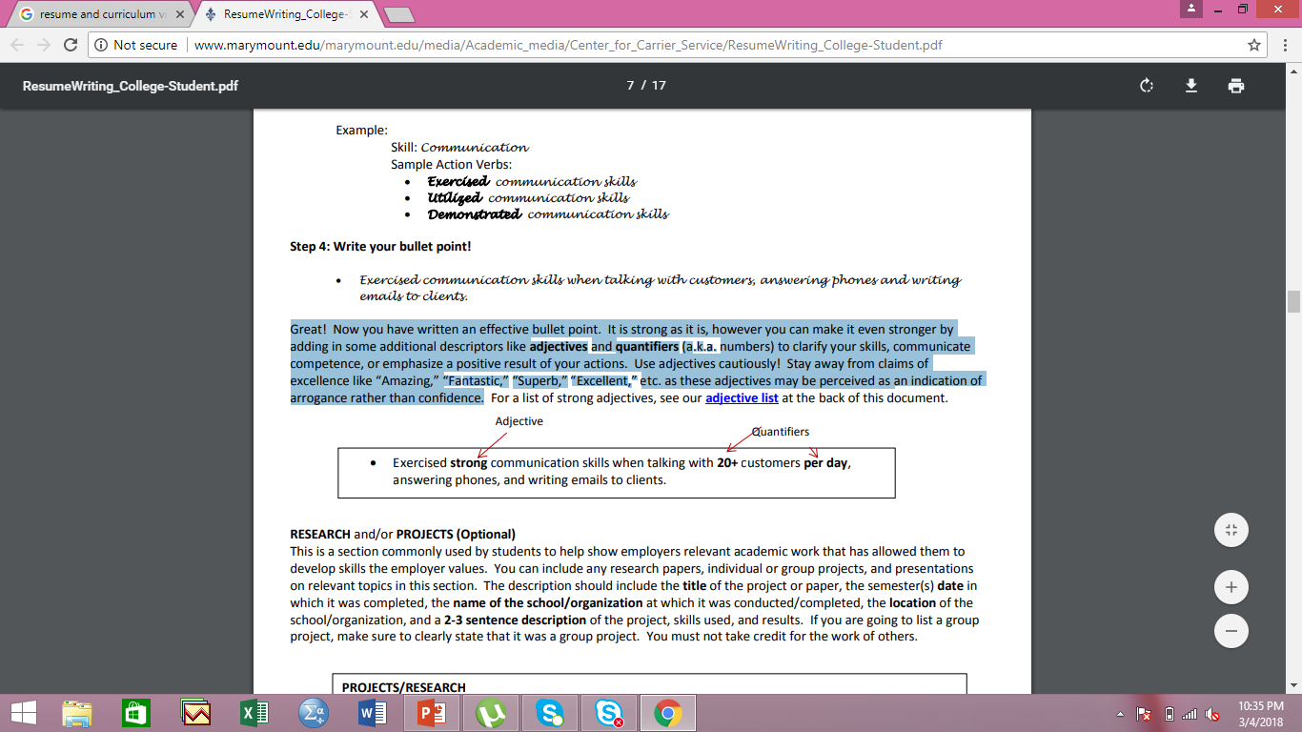
STEP-5
you can make it stronger by adding in some additional descriptors like adjectives and quantifiers to clarify your skills, communicate competence, or emphasize a positive result of your actions.
Use adjectives cautiously! Stay away from claims of excellence like “Amazing,” “Fantastic,” “Superb,” “Excellent,” etc. as these adjectives may be perceived as an indication of arrogance rather than confidence.

Slide 26
RESEARCH and/or PROJECTS
This is a section commonly used by students to help show employers relevant academic work that has allowed them to develop skills the employer values.
You can include any research papers, individual or group projects, and presentations on relevant topics in this section.
Ethical consideration: If you are going to list a group project, make sure to clearly state that it was a group project. You must not take credit for the work of others.

Slide 27
THE DESCRIPTION SHOULD INCLUDE
the title of the project or paper
the semester(s) date in which it was completed
the name of the school/organization at which it was conducted/completed
the location of the school/organization
2-3 sentence description of the project
skills used, and results.

Slide 28
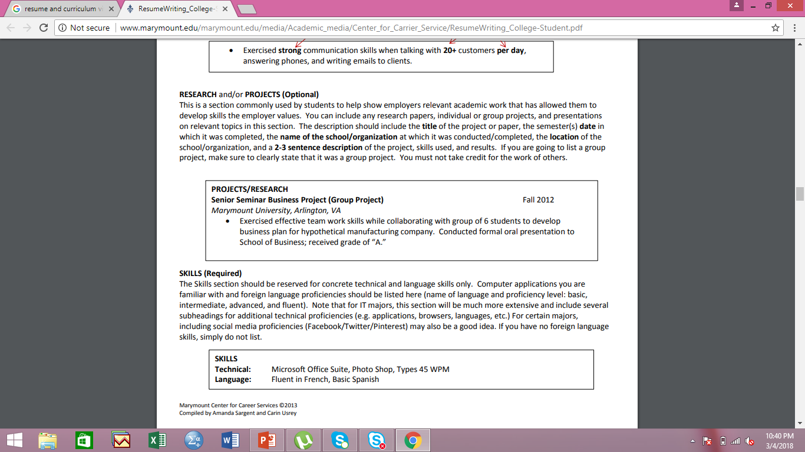

Slide 29
SKILLS
The Skills section should be reserved for concrete technical and language skills only.
Computer applications you are familiar with and foreign language proficiencies should be listed here (name of language and proficiency level: basic, intermediate, advanced, and fluent).
Note that for IT majors, this section will be much more extensive and include several subheadings for additional technical proficiencies (e.g. applications, browsers, languages, etc.)
For certain majors, including social media proficiencies (Facebook/Twitter/Pinterest) may also be a good idea.
If you have no foreign language skills, simply do not list.

Slide 30
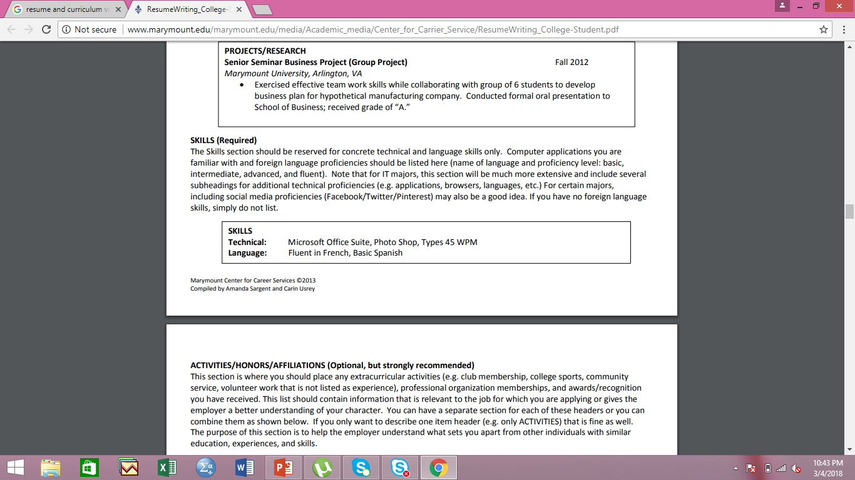

Slide 31
ACTIVITIES/HONORS/AFFILIATIONS
This section is where you should place any extracurricular activities (e.g. club membership, college sports, community service, volunteer work that is not listed as experience),
professional organization memberships, and awards/recognition you have received.
This list should contain information that is relevant to the job for which you are applying or gives the employer a better understanding of your character.
You can have a separate section for each of these headers or you can combine them as shown below. If you only want to describe one item header (e.g. only ACTIVITIES) that is fine as well.
The purpose of this section is to help the employer understand what sets you apart from other individuals with similar education, experiences, and skills.

Slide 32
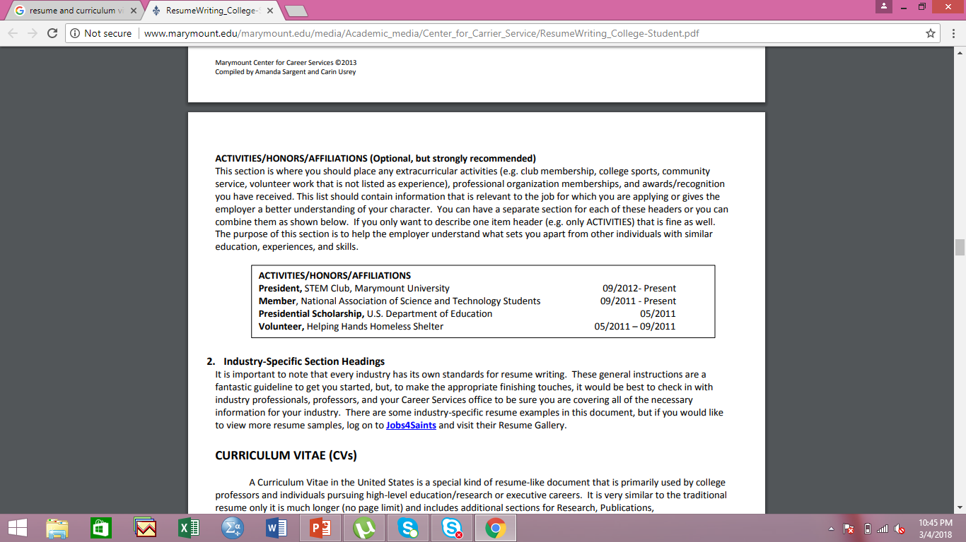

Slide 33

Job Advertisement

Slide 34


Slide 35


Slide 36


Slide 37


Slide 38


Slide 39


Slide 40
Cover Letter Writing
The cover letter typically accompanies your resume when you are applying for a position.
It should be specific to the position that you are applying for.
The cover letter is a business document.
It should be formatted with a business heading and left aligned.

Slide 41
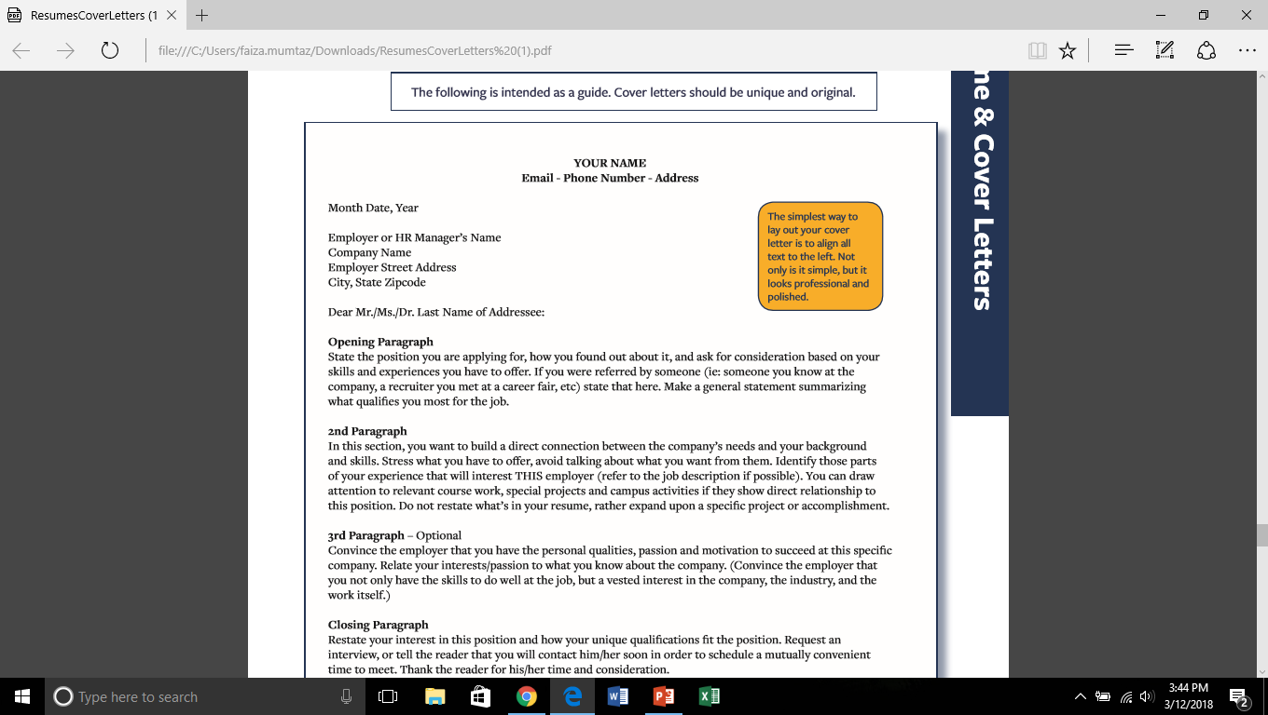
FORMAT

Slide 42
Opening Paragraph
State the position you are applying for
how you found out about it state that here
Make a general statement summarizing what qualifies you most for the job.

Slide 43
2nd Paragraph
In this paragraph, you want to build a direct connection between the company’s needs and your background and skills
Stress what you have to offer
avoid talking about what you want from them
You can draw attention to relevant course work
special projects and campus activities if they show direct relationship to this position

Slide 44
3rd Paragraph – Optional
Convince the employer that you have the personal qualities, passion and motivation to succeed at this specific company.
Relate your interests/passion to what you know about the company

Slide 45
Closing Paragraph
Restate your interest in this position and how your unique qualifications fit the position
Request an interview, or tell the reader that you will contact him/her soon in order to schedule a mutually convenient time to meet.
Thank the reader for his/her time and consideration

